Slide 1
Translating research findings into policy/action
Dr. Poonam Rishal
Co-investigator HERA 2, Nepal
ECR workshop, 31st January, 2022

Slide 2
Knowledge Mobilization
Knowledge Mobilization (KMb) is the act of translating formal research knowledge and outcomes into useful knowledge for the public sphere, ideally leading to social change.

Slide 3
Knowledge mobilization includes
production of research results, including knowledge synthesis
dissemination
transfer
exchange
co-creation or co-production
Notes:
Encompasses a wide range of activities

Slide 4
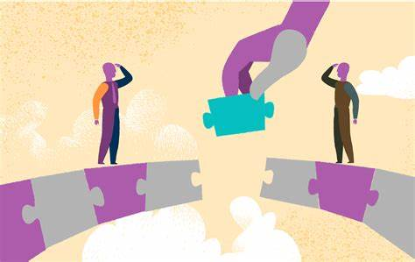
Knowledge mobilization
Bridges the gap between subject experts and researchers with policy-makers and practitioners, creating a reciprocal flow in the uptake of information.

Slide 5
Promoting Relationships and Eliminating Violence Network’s knowledge mobilization co-produced pathway to impact,

Slide 6
How to engage the policy makers
Stakeholder mapping
Lobby- communication with legislature/ request
Engagement with policy makers/ stakeholders

Slide 7
Engaging key decision makers
Who are key decision makers?
What are the actions you want them to take?
Who are key decision makers?
People who decide action/ finance at the highest level in the government
Eg. President, health minister, governors
Develop guidelines/ policies/laws
Increase budget
Agree to expand services

Slide 8
Stakeholder analysis
High power low interest
High power high interest
Low power low interest
Low power high interest
Notes:
Stakeholder analysis is a tool employed to recognize priorities and identify potential partnerships that can influence the outcome of advocacy
HIGH POWER, HIGH INTEREST
These people command attention at all times. It could be a hands-on investor or Chief Executive Officer (CEO) of the organization. Getting stakeholders to buy-in from this group is critical to achieving goals and someone must monitor them closely.
HIGH POWER, LOW INTEREST
These are the people who wield power but aren’t interested in the organization’s operations on a day-to-day basis. It could include a trade organization that provides certification or a community group. It’s important to reach out to these people, but it’s unnecessary to involve them in business decisions or communications.
HIGH INTEREST, LOW POWER
They will be closely involved with the business or project, but have a minimal say in the decision-making. However, this doesn’t mean they don’t have a role to play and keeping them informed is important. If an organization is building a new factory, the local community would be included in this category.
LOW POWER, LOW INTEREST
These are the people who aren’t highly involved with the organization or the project and have limited control in the stakeholder matrix. However, by keeping them in mind and monitoring them loosely, the project manager will make sure they’ve missed nothing. This group could include the public or the organization's future employees.

Slide 9
Stakeholders interests and influence for change
Notes:
Decision makers are faced with several important policy priorities within and beyond the health sector
Following stakeholder mapping, it is our job to understand the decision maker’s priorities, build their interest on the issue through evidence based advocacy for example by sharing information on the long term health and economic benefits of addressing GBV

Slide 10
How to reach out to the policy-makers/ stakeholders
Formal
Organize roundtable meetings for parliamentarian, ministers, director Generals
One on one meetings with relevant stakeholders
Write a letter to decision makers
Informal
Build on personal relationships- pay courtesy visits to relevant stakeholder, invite to programs,
hold informal meetings, attend social gatherings with them and raise casual discussions around vaccine financing,
make phone calls or send text messages

Slide 11
Notes:
Key message creates focus, control, and intensity in influencing the target audience. It is the foundation of communication strategy

Slide 12
A good key message
Is factually accurate but goes beyond findings
Answers the questions: who cares and why
Gives a bigger picture by providing the context, a sense of urgency, and/or possible next steps
May reflect just one study but the whole body of research; is not necessarily time-sensitive
Notes:
Concise: Maximum 3 key messages per page; each statement only 1-3 sentences long or under 30 seconds when spoken.
Strategic: Define, differentiate and align with benefits/value proposition.
Relevant: Balance what you need to communicate with what your audience needs to know.
Compelling: Meaningful information designed to stimulate action.
Simple: Easy-to-understand language; minimal jargon and acronyms.
Memorable: Easy to recall and repeat; avoid run-on sentences.
Relatable: Active rather than passive voice; no advertising slogans.
Tailored: Adaptable to different target audiences, with flexible language and depth of information.

Slide 13
Concise: Maximum 3 key messages per page; each statement only 1-3 sentences long or under 30 seconds when spoken.
Strategic: Define, differentiate and align with benefits/value proposition.
Relevant: Balance what you need to communicate with what your audience needs to know.
Compelling: Meaningful information designed to stimulate action.
Simple: Easy-to-understand language; minimal jargon and acronyms.
Memorable: Easy to recall and repeat; avoid run-on sentences.
Relatable: Active rather than passive voice; no advertising slogans.
Tailored: Adaptable to different target audiences, with flexible language and depth of information.

Slide 14
How to deliver a message
Speak simply and clearly
Obsess about accuracy, but let go of precision
Know your audience
Clear desired action, AKA “what are you asking”

Slide 16
Think “Glocal”
Globally as well locally

Slide 17
Effective storytelling
Simple language
Force of empathy
Back you stories with data
Be concise
Focus on one person for family
Include a call-to-action
Tailor the story according to your audience

Slide 18
Tell a story
Notes:
Why tell a story?
How we learn
How policymakers learn
How policymakers communicate with the public
Count individual person’s stories

Slide 19
Story of resilience during Covid 19 Pandemic

Slide 20
Stories of strength

Slide 21
Storytelling combines emotions and acts human narratives

Slide 22
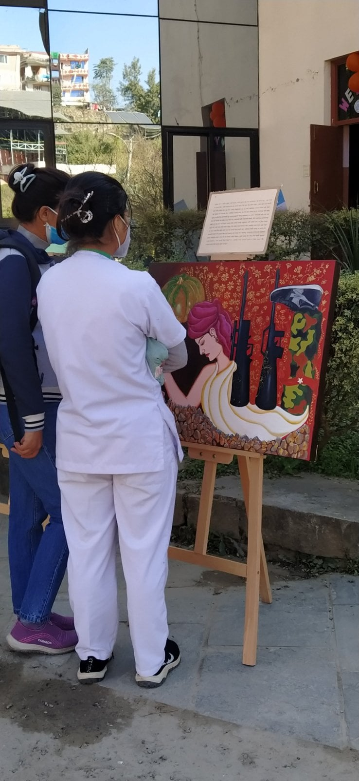
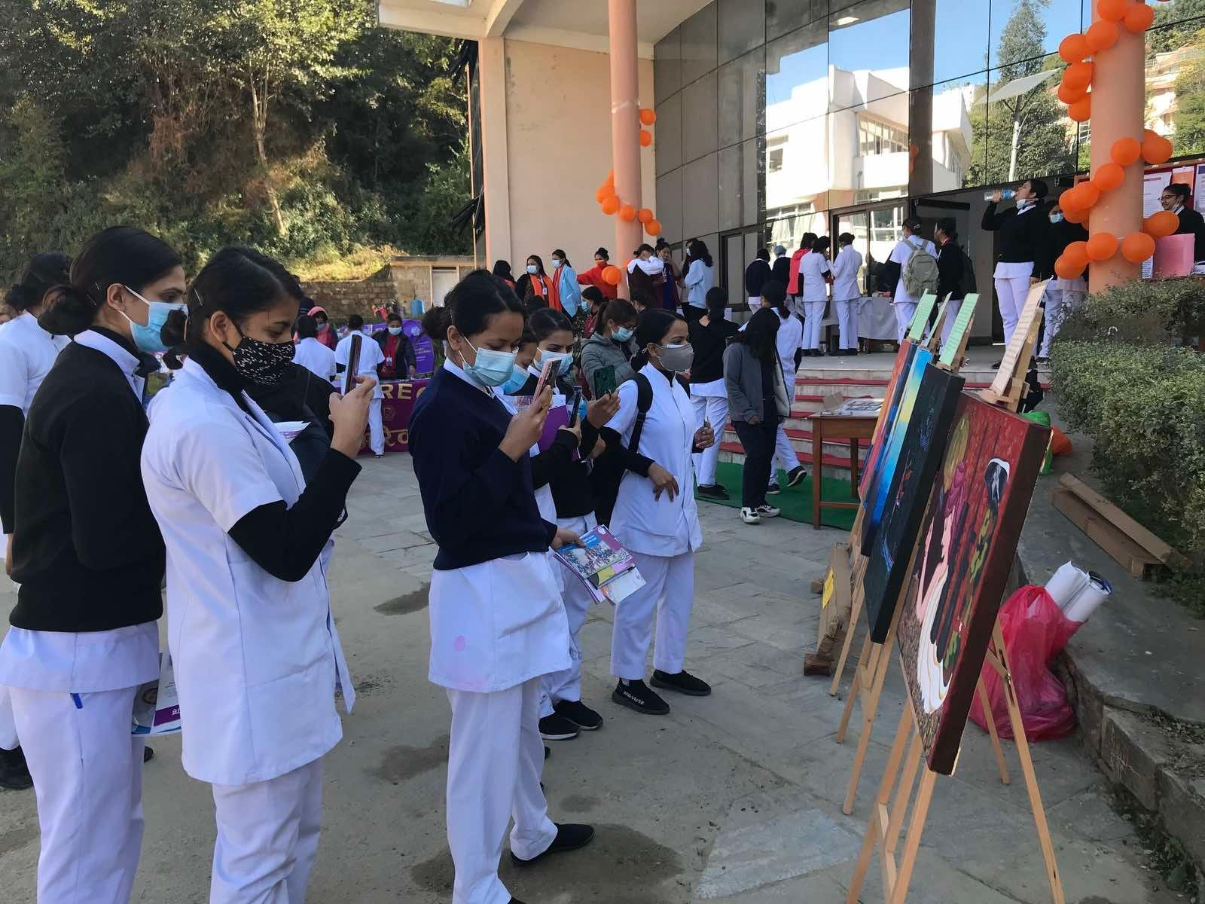

Slide 23
Thank you…
People hear statistics but they feel stories

